Slide 1

Why Haven’t We Left Yet?
Lee Santos
George Athitakis

Slide 2
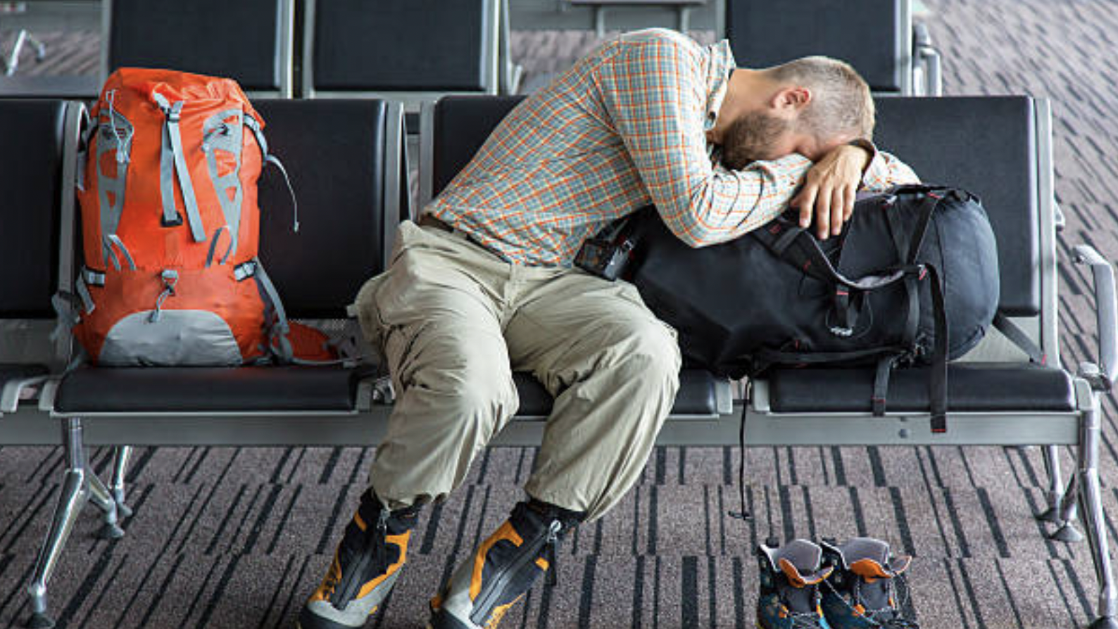
What are we looking for?
Which flights will be delayed?
Why are they delayed?
Notes:
Which – determine which flights might need greater attention to facilitate to process of departure and arrival
Why – which aspects of the arrival and departure process have been over-looked and where resources should be allocated

Slide 3
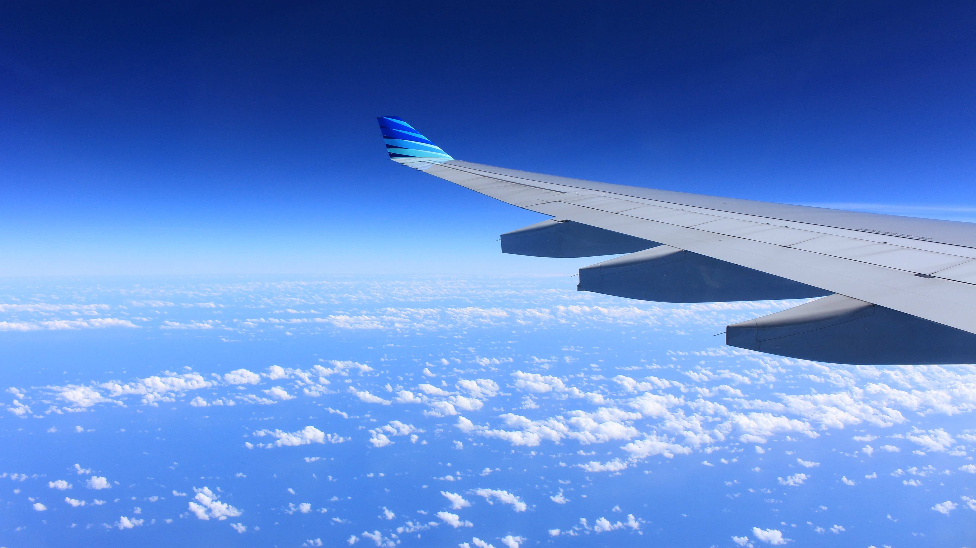
Why should we care?
Delayed Flights are an issue to all stakeholders in the air transit industry
Cargo and freight
Passengers
Airport
Airline
Notes:
Cargo – miss delivery deadlines
Passengers – miss connecting flights and personal engagements
Airport – loss of revenue as flights are delayed and eventually cancelled, snow-ball effect – can’t fill the other planes until current plane is done. Can’t do that if it hasn’t landed yet
Airliner - Creates negative attitude towards airline when reputation means everything in todays social media environment

Slide 4

Who’s to blame?
Flight specific information
Which airlines are the biggest offenders
Which airports have the largest delays
Passenger specific information
Notes:
Flight specific – is the issue due to airlines or airports? Both?
Passenger specific – how did the number of passengers affect flight delays, are they the problem? Or is the between more passengers and a larger plan mean it take longer to get the aircraft up and running

